Slide 1
Automatic News Curator

Slide 2
Content
1
Business Challenges
2
User Interviews
3
Implementation
4
Evaluation
5
Operational Challenges

Slide 3
1. Business Challenges
Business users, Tax team, spent 3 hours daily just to read articles about tax news. There are 8 tax experts in the team. In total it was 480 manhours.
After reading and prioritizing articles, they discuss among team members on action items.
The Managing Director, our business champion, felt her team could switch the manhours to focus on the discussion by leveraging AI/ML technology.

Slide 4
2. User Interviews
After the discussion with business champion, we conducted user interviews to better understand their needs at working level. The synthesis are:
Overall, there is no time to read articles because there is overwhelming amount of info.
4
The team wants a bookmark feature to save articles they want to discuss and the system will broadcast the event to all members.
1
2
The team wants an automated way to categorize live news articles.
5
The team wants to add notes to articles or post updates on news feed.
3
The team wants daily summary and “Must Read” feed.
The project uses Agile methodology and breaks the delivery into several phases. A sprint duration is 2 weeks and will be reviewed with business champion.
We decided to use Deloitte Taxathand, Bloomberg Tax, KPMG, and EY as pilot data sources because of high data quality, user familiarity, and high data frequency.

Slide 5
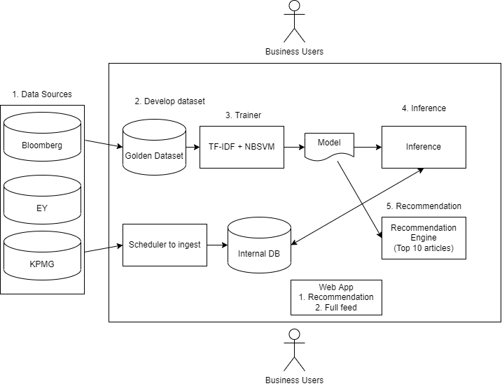
3. Implementation : Proposed Technical Diagram
1
Collect title and abstract from data sources
2
Develop full and golden dataset
3
Train NLP model*. Run monthly
4
Infer with output model
5
Generate recommendations
* Evaluation metrics are:
Accuracy
F1-score

Slide 6
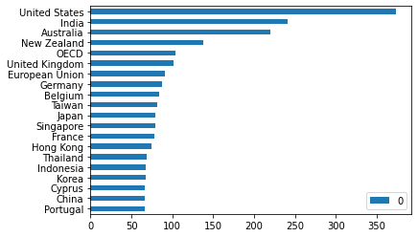
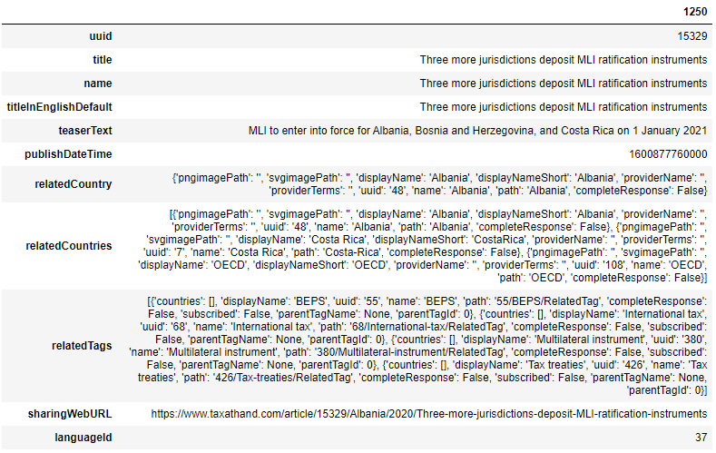
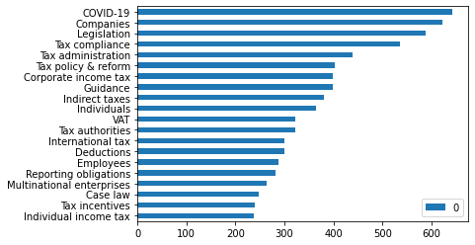
3. Implementation : Sample EDA of Deloitte Taxathand
During EDA, we checked the API endpoint, features, data quality, and operationalization plan:
2
1
Table showing features we get from endpoint.
2
Graph showing countries Taxathand covers.
3
Graph showing topics in Taxathand
1
3

Slide 7
3. Implementation : Model Development
During development, we created the raw data just from title and abstract and pre-processed it to improve accuracy. The pre-process includes:
1
Conversion to lower case
2
White space trimming
3
Remove punctuations
4
Tokenization
We created golden dataset with business users. There were around 600 articles that they categorized. The process was quite easy because of the high data quality of some data sources.

Slide 8
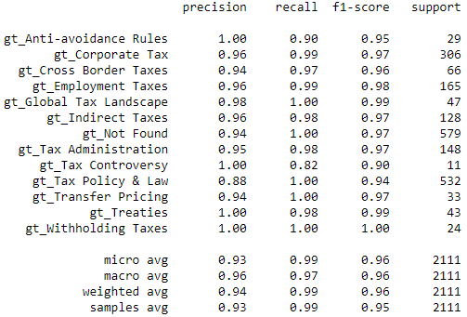
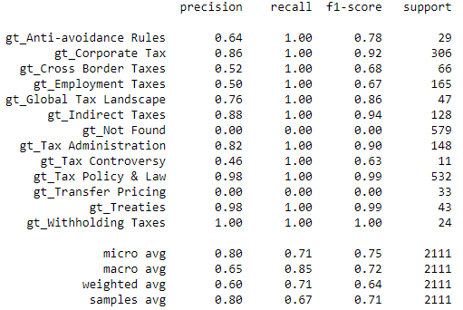
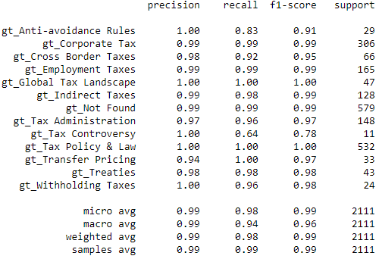
3. Implementation : Model Evaluation
We compared several models:
2
1
String matching
2
NBSVM
3
XGBoost
and decided to use NBSVM because of its f1-score and explainability.
1
3

Slide 9
4. Evaluation
1
IRS PLR: Distribution Period of Decedent’s IRAs to Be Determined With Trust’s Beneficiaries as Designated Beneficiaries, Based on Spouse’s Life Expectancy (IRC §401)
The beneficiaries of a trust will be treated as designated beneficiaries of a decedent’s six Individual Retirement Accounts in determining the applicable distribution period, which will be calculated based on the life expectancy of the surviving spouse, the IRS ruled. Trust, which is the sole named beneficiary of each of the Decedent IRAs, meets the four requirements (concerning trust status and identifiability of beneficiaries) of Treasury Regulations Section 1.401(a)(9)-4, Q&A-5, for determining that Trust's beneficiaries (not Trust itself) are the Decedent IRAs' designated beneficiaries. Among the beneficiaries taken into account for purposes of determining the distribution period, Spouse has the shortest life expectancy, which is determinative, and the other individuals upon Spouse's death are entitled to remaining assets, the IRS stated. [PLR 202044001]
Predicted tags: Employment Taxes, Tax Policy and Law
2
INSIGHT: ’Newman’s Own’ Exception to Excess Business Holdings Rule Allows Private Foundations to Own 100% of a Business Enterprise
Richard Fox and Joshua Headley of Buchanan Ingersoll discuss the "Newman's Own" exception to the excess business holdings rule championed by the foundation set up by the late actor Paul Newman. The authors conclude that while the stringent requirements of the exception are apparently workable for Newman's Own Foundation, they might be insurmountable for other private foundations.
Predicted tags: Corporate Tax, Indirect Taxes, Tax Policy and Law

Slide 10
5. Operational Challenges
During operational stage, we noticed several issues:
Once a data provider blocked connections from servers
Solution: Change IP address
3
Users mislabelled articles and affected our models
Solution: New inputs to golden dataset need to be reviewed monthly.
1
2
Data source changed its data structure
Solution: Update data configuration

Slide 11
Thank you.

